Slide 1

Backend Tech Stack for Payment Systems
The essential components every payments engineer needs

Slide 2

CORE FOUNDATION
Language & Framework
Java 17 (LTS)
Production-stable, actively maintained, and battle-tested for enterprise systems
Maven + Spring Boot
Dependency management via pom.xml
Spring Web for REST APIs
Spring MVC architecture
Built-in validation
No need to reinvent the wheel—focus on business logic.

Slide 3

Database & Security Layer
Database
MySQL or PostgreSQL
Hibernate (JPA) for ORM
Spring Data JPA
Entities: User, Account, Transaction, Payment, AuditLog
Security
Spring Security + JWT
Token-based authentication
BCrypt password hashing
No plain text passwords
No session-based auth

Slide 4

Transaction Handling
Validate Input
Core Components
Spring @Transactional annotation
Execute @Transactional
Database-level ACID guarantees
Rollback on Failure
Automatic rollback handling
Example: POST /api/v1/payments/transfer
ACID-compliant transactions ensure data integrity and automatic rollback on errors.

Slide 5
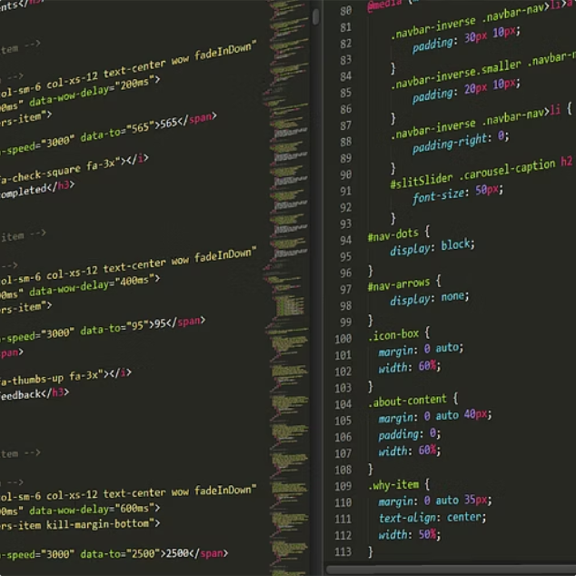


FRONTEND
UI Stack: Simple & Responsive
HTML5 + CSS3
Bootstrap 5
JavaScript
Semantic markup and modern styling
Fast, responsive, professional-looking UI out of the box
Vanilla JS or minimal jQuery. Fetch API for backend calls. Keep it simple.

Slide 6
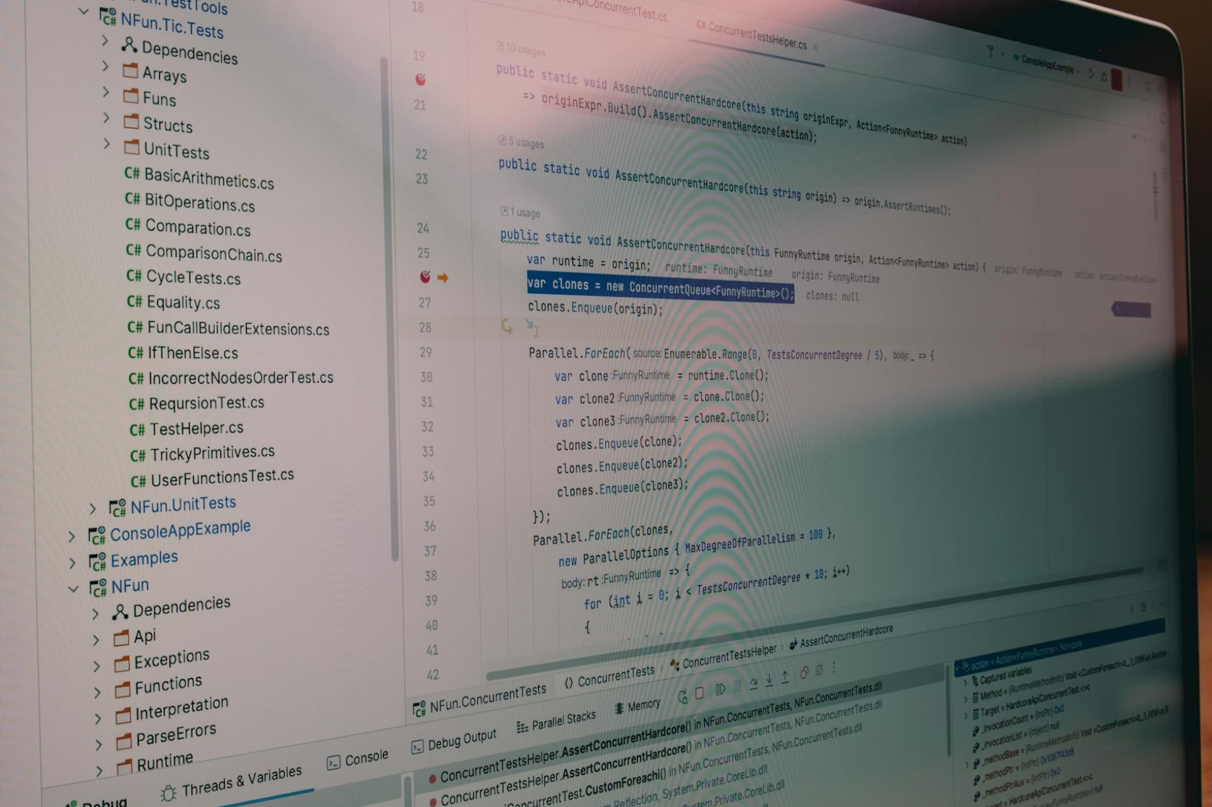
Testing & Tools
Testing Stack
JUnit 5 for unit tests
Mockito for mocking
Spring Boot Test suite
Test payment success, insufficient balance, and rollback scenarios.
Development Tools
eclipse
Postman for API testing
Git + GitHub
MySQL Workbench
Optional Enhancements
Swagger/OpenAPI for API docs
Lombok to reduce boilerplate
H2 for in-memory testing

